Slide 1

DriverPass System Analysis
Thanh Nguyen
Notes:
Hello everyone! Today, I'm thrilled to share the exciting details of our DriverPass system design. We're on a mission to make driver training better and more convenient. Let's explore the specifics.

Slide 2

System Requirements
Access data online and offline
Ensure data security with different access levels
Track user activities for accountability
Provide reservation functionality for driving lessons
Allow online and offline appointment scheduling
Ensure compatibility with various devices (computers, mobile)
Notes:
Functional Requirements Speaker Notes:
"Let's talk about what the system can do – the functional requirements. First off, we've made it super easy for users to book driving lessons. You know, schedule, change plans, or cancel online – it's all there, making things convenient for customers."
"We're also making sure Liam, the boss, stays in the loop. There's a solid system for tracking reservations. Who booked, who canceled, it's all recorded. Liam can generate reports whenever he needs to, keeping everything transparent and organized."
Nonfunctional Requirements Speaker Notes:
"Now, let's get into how the system performs – the nonfunctional stuff. Security is big – Ian needs special access to manage accounts securely. We're also setting up the system in a way that makes it reliable, always available online or offline. Backups and security are sorted, ensuring smooth operations for DriverPass."
"Oh, and compliance. Liam wants to stay updated with the DMV rules. So, we've got a connection to the DMV for regular updates. The system will always have the latest info, keeping DriverPass in the clear and up to date."

Slide 3
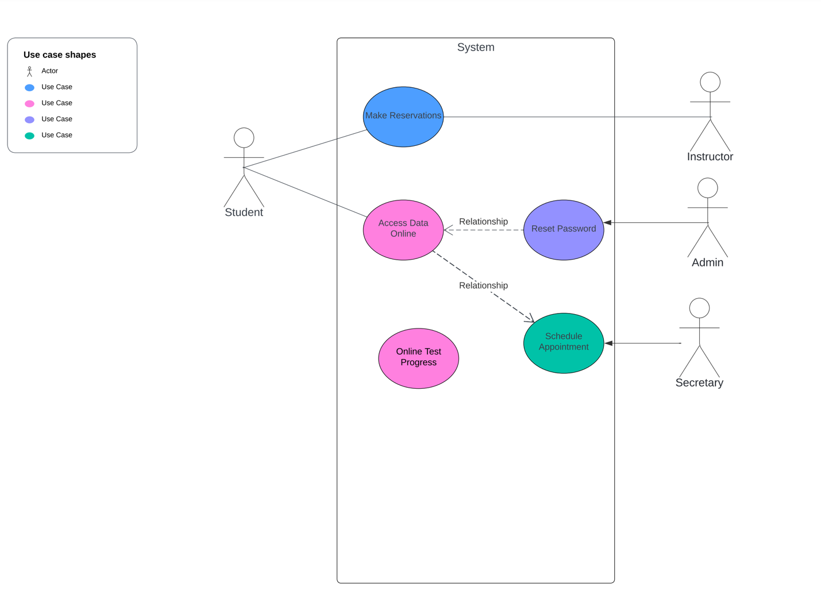
Use Case Diagram
Notes:
Let's break down our DriverPass world. We've got the stars of the show – the students, instructors, secretary, and admin. Now, picture this: students reserving their driving lessons, instructors accessing essential data, the secretary making appointments seamless, and the admin ensuring everything runs like a well-oiled machine. Oh, and don't forget the online tests – our digital pit stops for the students to show their skills. It's a dance of actions, all designed to make DriverPass the go-to for top-notch driving training."

Slide 4
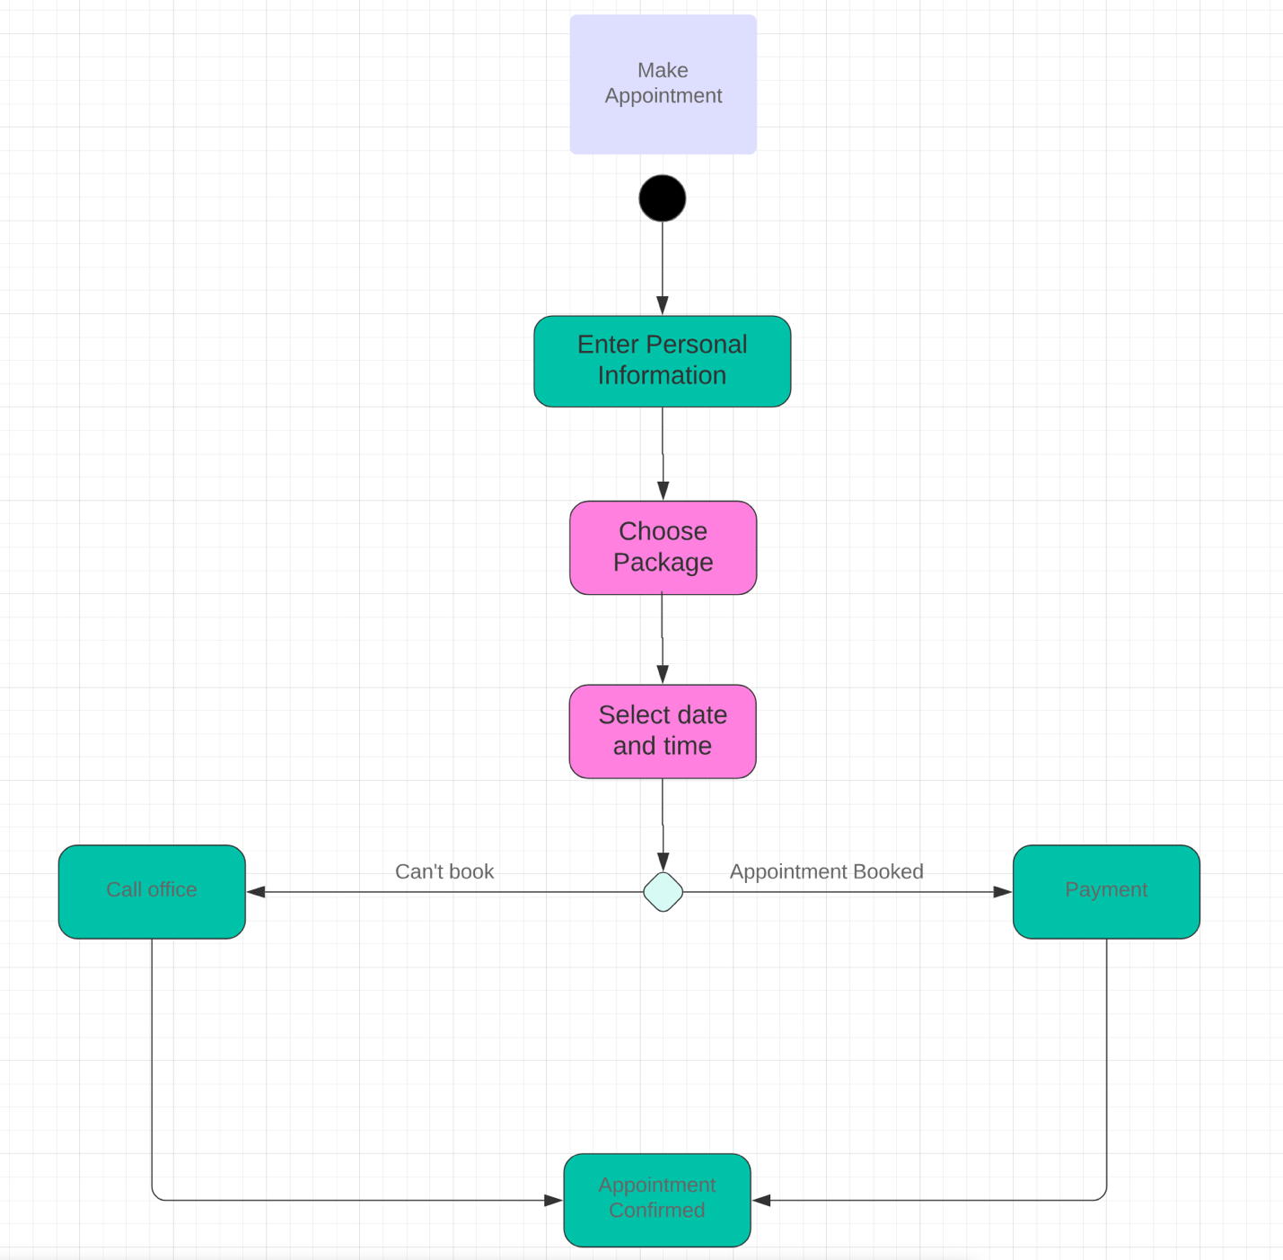
Activity Diagram
Notes:
"Let me walk you through the seamless journey of scheduling a driving lesson with DriverPass. Whether you prefer the convenience of our online platform or a friendly chat with our secretary, we've got you covered."
"Step one: Kick off your appointment request. It's as easy as a click online or a quick call to our office."
"Step two: Select your ideal package. We offer a range of options tailored to different skill levels and lesson durations, ensuring there's something for everyone."
"Step three: Dive into our calendar to choose the perfect date and time that aligns with your schedule."
"Step four: Confirm your details. Take a moment to review and ensure all your personal information is accurate – name, address, and contact details."
"Step five (for online bookings): Head to our secure payment gateway to complete the payment process, ensuring a hassle-free transaction."
"Step six: Once your payment is confirmed online or after a pleasant call with our secretary for offline bookings, your appointment is officially locked in. It's that simple and tailored to make your experience with DriverPass exceptional."

Slide 5
Security
Different access levels for employees
Secure online data access and modification
Activity tracking for accountability
Password reset functionality
Notes:
Ensuring your data is safe and secure is a top priority for us at DriverPass. Let me share a bit about how we've thought about security in our system without diving into complex technical details."
"Firstly, we've implemented measures to safeguard your personal information. Our system is designed to protect details like your name, address, and payment information from any unauthorized access."
"When it comes to access, we've set up different levels for our team members. This means that only authorized personnel have the right level of access, adding an extra layer of protection."
"For your online activities, like making payments, we've integrated a secure payment gateway. This ensures that your financial transactions are encrypted and protected, giving you peace of mind."
"Additionally, our system keeps a watchful eye on any changes made, providing a transparent record of activities. This way, we can quickly identify and address any unusual occurrences."
"In a nutshell, your security is at the forefront of our design. We've taken steps to protect your personal information, control access, and secure online transactions, all aimed at providing you with a safe and trustworthy experience with DriverPass

Slide 6
System Limitations
Dependency on internet connectivity for real-time data access
Initial dependency on system administrator for module modifications
Limited customization options for non-developers
Notes:
"While we've crafted a system with your convenience in mind, it's important to be transparent about some limitations."
"Firstly, our system relies on internet connectivity for real-time access to data. This means that certain features may be affected if you're in an area with poor internet reception."
"In the initial stages, modifications to certain modules might require assistance from our system administrator. However, we're actively working on making this process more user-friendly in the future."
"For non-developers, customization options are a bit limited. While we've kept the system user-friendly, extensive modifications may still need input from a tech-savvy individual."
"We're continuously looking for ways to enhance these aspects and appreciate your understanding as we work to make DriverPass even more efficient and user-centric."

